Slide 1
Ecommerce Recommender System
Content Table
SI No. | Section
1 | Team
2 | Objective
3 | Source Code
4 | Output
5 | Use Cases
6 | Proposed solution
7 | Limitations & future scope

Slide 2


Our objective & proposed solution
Our objective was to elevate the user experience through the implementation of a personalized product ranking system. Through dedicated efforts, we've crafted a sophisticated machine learning model capable of producing precise and pertinent product rankings tailored to each user. This ranking system takes into account a multitude of factors, including historical interactions, product trends, and user affinities. By harnessing these insights, it adeptly forecasts and suggests the optimal products for every individual, aligning with their distinctive traits and preferences.
Our Objective
We have solved the given problem statement using a machine learning recommender system. The model uses collaborative filtering algorithm to provide accurate recommendations on the basis of past user interactions. In order to tackle the cold start problem we have implemented a rank based collaborative filtering algorithm which suggests the highest rated products to new users.
Proposed Solution

Slide 3
Source Code:
1. User Based Collaborative Filtering (1/3)
import warnings
warnings.filterwarnings('ignore')
import numpy as np
import pandas as pd
import matplotlib.pyplot as plt
import seaborn as sns
from sklearn.metrics.pairwise import cosine_similarity
from sklearn.metrics import mean_squared_error
df = pd.read_csv('data.csv', header=None)
df.columns = ['user_id', 'prod_id', 'rating']
df_copy = df.copy(deep=True)
rows, columns = df.shape
print("No of rows = ", rows)
print("No of columns = ", columns)
df.info()
df.isna().sum()
df['rating'].describe()
plt.figure(figsize = (12,6))
df['rating'].value_counts(1).plot(kind='bar')
plt.show()
print('Number of unique USERS in Raw data = ', df['user_id'].nunique())
print('Number of unique ITEMS in Raw data = ', df['prod_id'].nunique())
most_rated = df.groupby('user_id').size().sort_values(ascending=False)[:10]
most_rated
counts = df['user_id'].value_counts()
df_final = df[df['user_id'].isin(counts[counts >= 50].index)]

Slide 4
Source Code:
1. User Based Collaborative Filtering (2/3)
import warnings
warnings.filterwarnings('ignore')
import numpy as np
import pandas as pd
import matplotlib.pyplot as plt
import seaborn as sns
from sklearn.metrics.pairwise import cosine_similarity
from sklearn.metrics import mean_squared_error
df = pd.read_csv('data.csv', header=None)
df.columns = ['user_id', 'prod_id', 'rating']
df_copy = df.copy(deep=True)
rows, columns = df.shape
print("No of rows = ", rows)
print("No of columns = ", columns)
df.info()
df['rating'].describe()
#Create the plot and provide observations
plt.figure(figsize = (12,6))
df['rating'].value_counts(1).plot(kind='bar')
plt.show()
print('Number of unique USERS in Raw data = ', df['user_id'].nunique())
print('Number of unique ITEMS in Raw data = ', df['prod_id'].nunique())
most_rated = df.groupby('user_id').size().sort_values(ascending=False)[:10]
most_rated
counts = df['user_id'].value_counts()
df_final = df[df['user_id'].isin(counts[counts >= 50].index)]

Slide 5
Source Code:
1. User Based Collaborative Filtering (3/3)
similar = similar_users(3,final_ratings_matrix)[0][0:10]
print(similar)
print(similar_users(3,final_ratings_matrix)[1][0:10])
print(similar_users(1521,final_ratings_matrix)[1][0:10])
def recommendations(user_index, num_of_products, interactions_matrix):
most_similar_users = similar_users(user_index, interactions_matrix)[0]
prod_ids = set(list(interactions_matrix.columns[np.where(interactions_matrix.loc[user_index] > 0)]))
recommendations = []
observed_interactions = prod_ids.copy()
for similar_user in most_similar_users:
if len(recommendations) < num_of_products:
similar_user_prod_ids = set(list(interactions_matrix.columns[np.where(interactions_matrix.loc[similar_user] > 0)]))
recommendations.extend(list(similar_user_prod_ids.difference(observed_interactions)))
observed_interactions = observed_interactions.union(similar_user_prod_ids)
else:
break
return recommendations[:num_of_products]
recommended_products = recommendations(3,5,final_ratings_matrix)
print(recommended_products)
recommended_products = recommendations(1521,5,final_ratings_matrix)
print(recommended_products)

Slide 6
Source Code:
2. Rank Based Collaborative Filtering (Cold start problem) (1/2)
import warnings
warnings.filterwarnings('ignore')
import numpy as np
import pandas as pd
import matplotlib.pyplot as plt
import seaborn as sns
from sklearn.metrics.pairwise import cosine_similarity
from sklearn.metrics import mean_squared_error
df = pd.read_csv('data.csv', header=None)
df.columns = ['user_id', 'prod_id', 'rating']
df_copy = df.copy(deep=True)
rows, columns = df.shape
print("No of rows = ", rows)
print("No of columns = ", columns)
df.info()
df['rating'].describe()
#Create the plot and provide observations
plt.figure(figsize = (12,6))
df['rating'].value_counts(1).plot(kind='bar')
plt.show()
print('Number of unique USERS in Raw data = ', df['user_id'].nunique())
print('Number of unique ITEMS in Raw data = ', df['prod_id'].nunique())
most_rated = df.groupby('user_id').size().sort_values(ascending=False)[:10]
most_rated
counts = df['user_id'].value_counts()
df_final = df[df['user_id'].isin(counts[counts >= 50].index)]

Slide 7
Source Code:
2. Rank Based Collaborative Filtering (Cold start problem) (2/2)
print('The number of observations in the final data =', len(df_final))
print('Number of unique USERS in the final data = ', df_final['user_id'].nunique())
print('Number of unique PRODUCTS in the final data = ', df_final['prod_id'].nunique())
final_ratings_matrix = df_final.pivot(index = 'user_id', columns ='prod_id', values = 'rating').fillna(0)
print('Shape of final_ratings_matrix: ', final_ratings_matrix.shape)
given_num_of_ratings = np.count_nonzero(final_ratings_matrix)
print('given_num_of_ratings = ', given_num_of_ratings)
possible_num_of_ratings = final_ratings_matrix.shape[0] * final_ratings_matrix.shape[1]
print('possible_num_of_ratings = ', possible_num_of_ratings)
density = (given_num_of_ratings/possible_num_of_ratings)
density *= 100
print ('density: {:4.2f}%'.format(density))
final_ratings_matrix.head()
df_final['rating'] = pd.to_numeric(df_final['rating'], errors='coerce')
average_rating = df_final.groupby('prod_id')['rating'].mean()
count_rating = df_final.groupby('prod_id')['rating'].count()
final_rating = pd.DataFrame({'avg_rating': average_rating, 'rating_count': count_rating})
final_rating = final_rating.sort_values(by='avg_rating', ascending=False)
final_rating.head()
def top_n_products(final_rating, n, min_interaction):
recommendations = final_rating[final_rating['rating_count'] > min_interaction]
recommendations = recommendations.sort_values('avg_rating', ascending=False)
return recommendations.index[:n]
top_products_1 = top_n_products(final_rating, 5, 50)
top_products_2 = top_n_products(final_rating, 5, 100)
print("Top products with minimum 50 interactions:", top_products_1)
print("Top products with minimum 100 interactions:", top_products_2)

Slide 8


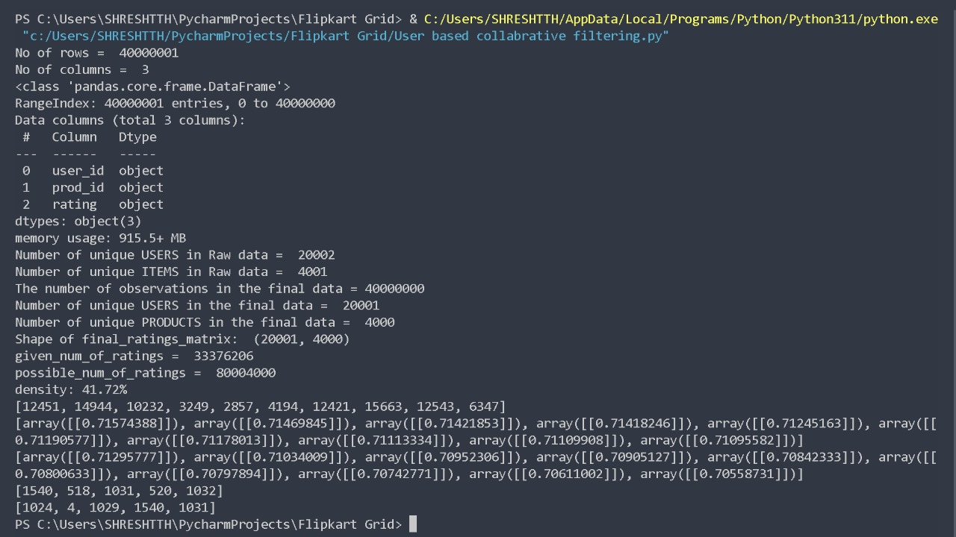
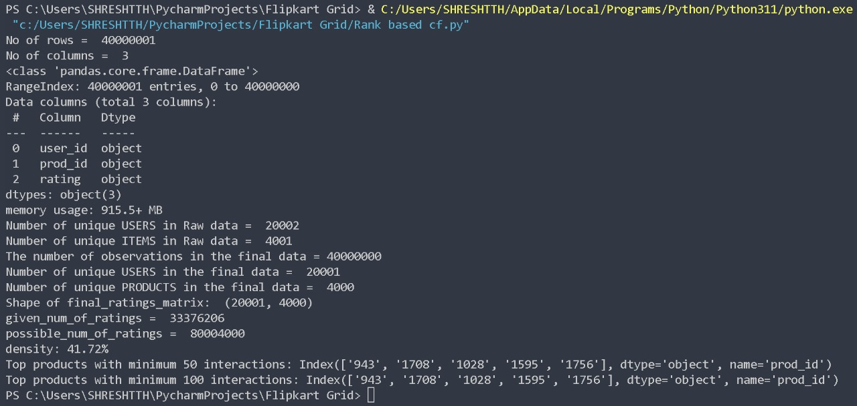
Output
Generated Dataset (link):
User Based:
Rank Based:

Slide 9



Use Cases for the applicability of the model
It seamlessly integrates into any e-commerce website, orchestrating the generation of precise and pertinent product recommendations. This augmentation of the user experience holds the potential to not only elevate user satisfaction but also catalyze a growth in the company's revenue. Notably, this model accommodates the needs of both seasoned regular users and those venturing onto the website for the first time.
1
The applicability of the model spans a diverse array of scenarios
2
In addition, e-commerce platforms specializing exclusively in distinct product categories like clothing, electronics, groceries, and more, can harness the model's capabilities to enhance their offerings and tailor their recommendations accordingly.

Slide 10




Solution statement and proposed approach (1/2)
1. User Based Collaborative Filtering
The algorithm used in the provided code is a user-based collaborative filtering recommendation system. Collaborative filtering is a technique for making automatic predictions (filtering) about the preferences of a user by collecting preferences from many users (collaborating). In this specific approach, the algorithm focuses on finding similar users to make recommendations for a target user. Here's how the algorithm works step by step:
1
Data Processing
2
Filtering Data
3
The algorithm leverages the preferences of similar users to make recommendations for a target user. It identifies users who have similar patterns of ratings and uses their preferences to suggest products that the target user might be interested in.
Creating Interaction Matrix
4
Similar User Identification
5
Creation of recommendations function to generate recommendation from a target user
6
Generating recommendations & testing

Slide 11




Solution statement and proposed approach (2/2)
2. Rank Based Collaborative Filtering
In the scenario where a novel user enters the system, the algorithm encounters a challenge in discerning their preferences. Consequently, it becomes incapable of identifying akin users from whom it could derive recommendations for products. To address this quandary, we've devised a rank-based collaborative filtering algorithm. This innovative approach facilitates the provision of prime product recommendations to newly onboarded users. Here's an elucidation of the algorithm's functioning:
1
Data Pre- processing
2
Filtering Data & Creating Interaction Matrix
The algorithm focuses on recommending products that have received high average ratings while considering sufficient number of interactions to ensure recommendation reliability.
3
Calculating density of strings
4
Calculating Average rating & counts
5
Defining function for the top ‘n’ products recommendations

Slide 12



The proposed solution comes with a few limitations…..
The envisioned model does exhibit a few inherent constraints:
The efficacy of the model is contingent upon the quality of the dataset employed. Should the dataset be skewed in its composition, there's a considerable risk of inducing pronounced bias within the model. This, in turn, could significantly impede the model's overarching performance, resulting in recommendations that lack relevance and pertinence.
1
Notably absent from the model's considerations are pivotal demographic factors such as age, gender, and geographical location. These aspects, often pivotal in shaping individual preferences, are not factored into the model's framework.
2
A further limitation lies in the model's inability to account for specific interactions of distinct significance. Instances like wishlisting or cart additions, which hold unique value in gauging user intent and interest, are overlooked by the model's existing architecture.
3

Slide 13


Future Scope & benefits of the solution
The model can be utilized to curtail to multiple user needs while satisfying user problems
Potential to encompass supplementary dimensions
Enhanced Capabilities
Enhanced Utility
The model has the potential to encompass a myriad of supplementary dimensions, including refined dataset generation methods that encompass a broader spectrum of insights, like the duration a user engages with a product or intricate user demographic information. This augmentation could lead to heightened model precision and performance.
Moreover, the model's capabilities can be elevated through the integration of advanced ranking algorithms. A hybrid approach, fusing content-based and collaborative filtering techniques hinged on KNN(K-Nearest Neighbor), K-means, SVD(Singular Value Decomposition), and PCA(Principle Component Analysis), could furnish recommendations of superior quality by amalgamating diverse perspectives.
The model's utility can be further amplified by introducing product suggestions attuned to specific occasions. Employing an array of data science methodologies, machine learning frameworks, and even delving into the realm of deep learning, such an augmentation can provide users with contextually apt recommendations that align with their unique requirements.

